Slide 1

Software Defined Systems
Final Project
Name : P.A. Seneviratne
Index N.o : 2409356

Slide 2
Project Overview
This project is focused on creating Newborn Monitoring System in order to monitor the vitals of a newborn remotely and provide real-time updates of the vitals of the newborn. It can be defined as a software-defined IoT health monitoring system. The Monitoring System consists of the following components and services.
  Edge device collects vitals
  FastAPI makes up the backend which stores data in a database & serves data
  Dashboard visualizes live readings
  Deployed on OpenShift/Kubernetes

Slide 3
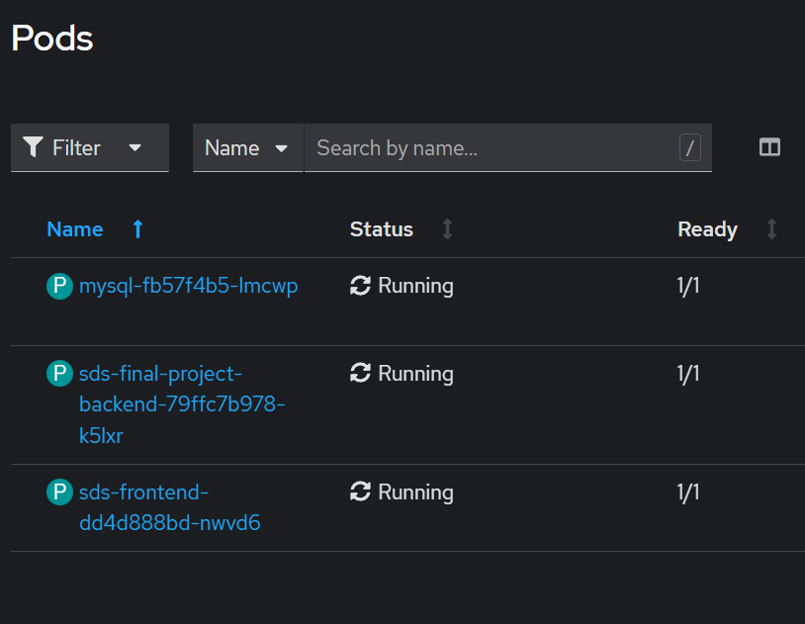
System Architecture
This system consists of the following components and micro-services which have been visualized in the following slide.
  Edge sensor device
  Backend API (FastAPI)
  MySQL database
  Frontend dashboard (Nginx + HTML/JS)
  Kubernetes Deployments, Services, Routes

Slide 4
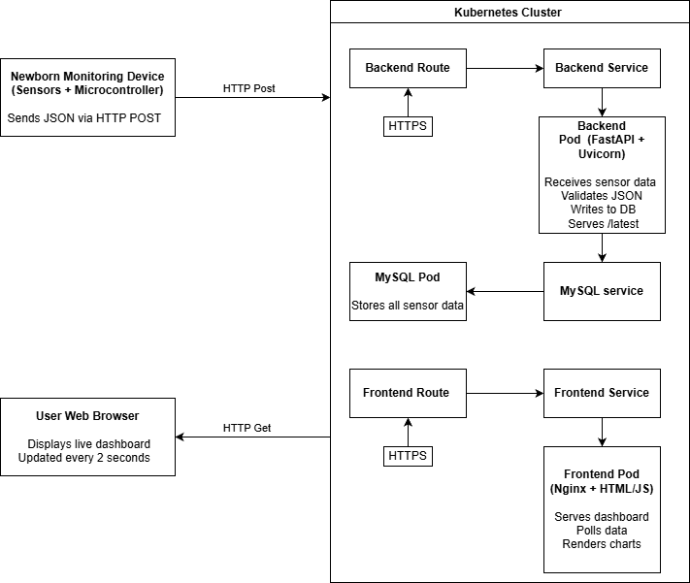
System Architecture

Slide 5
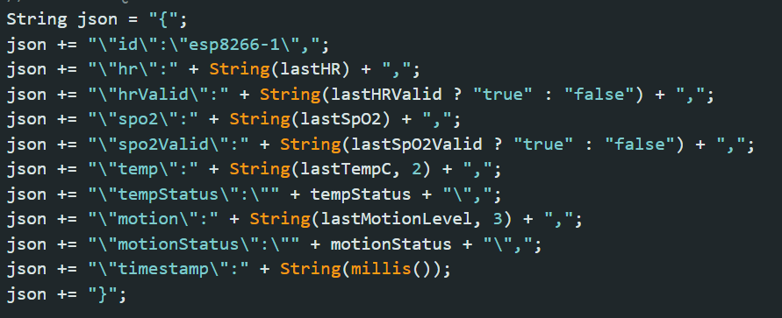
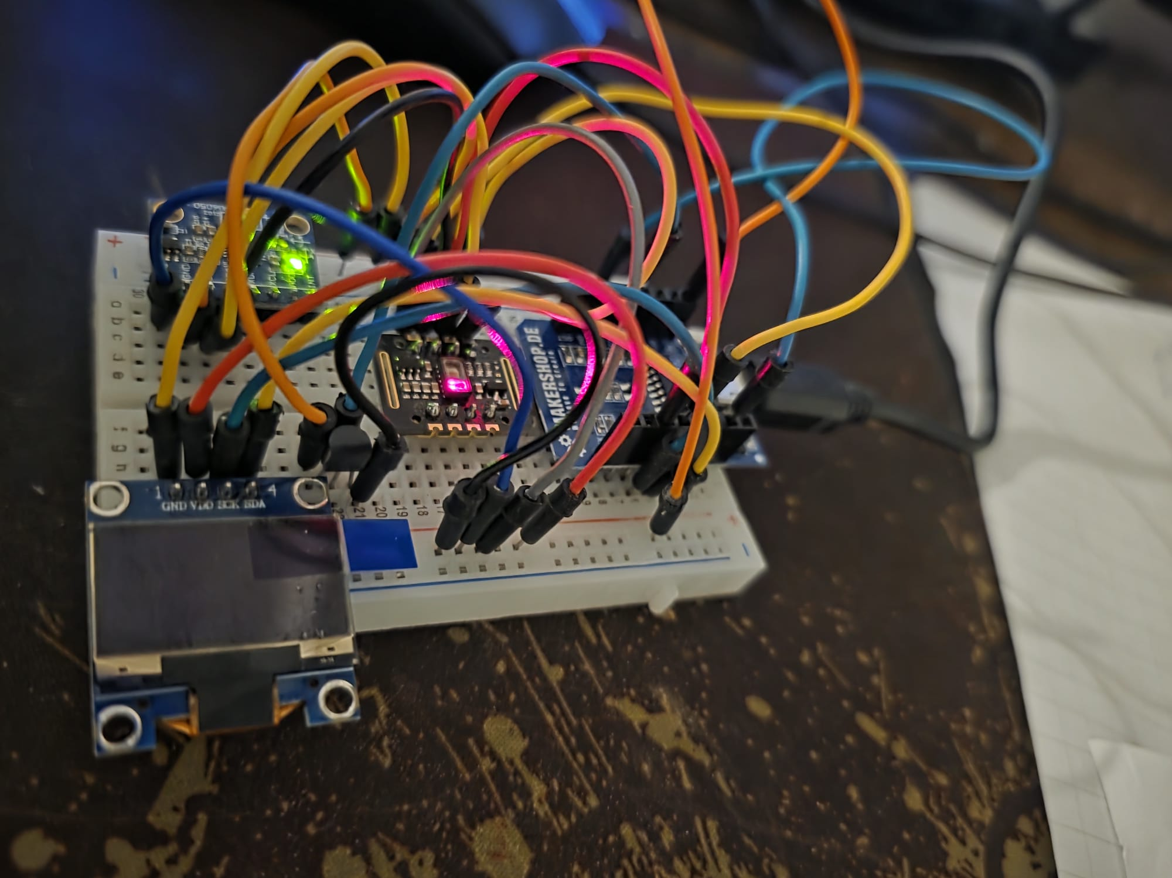
Edge Device Function
Measures HR, SpO₂, temperature, motion
Packages data as JSON
Sends periodic POST /api/data requests
Acts as the system’s data producer

Slide 6
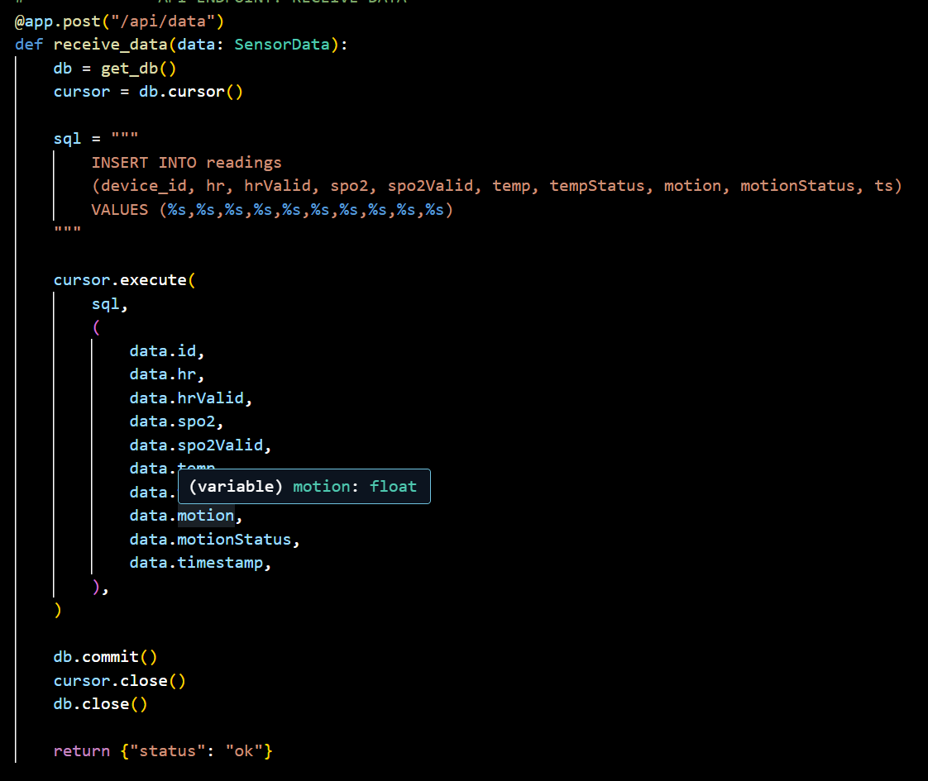
Backend Function
• Receives sensor data
• Validates via Pydantic
• Stores readings in MySQL
• Provides:
  POST /api/data
  GET /api/latest
  GET /api/history
• Handles CORS for dashboard access

Slide 7
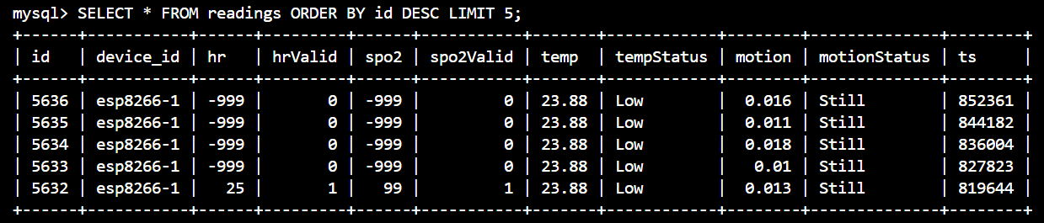
Database Layer (MySQL)
• “readings” table stores all metrics
• Key fields:
  hr,
  spo2,
  temp,
  motion,
  statuses,
  timestamps
• Backend queries newest record for dashboard
• Structured for future multi-device scaling

Slide 8
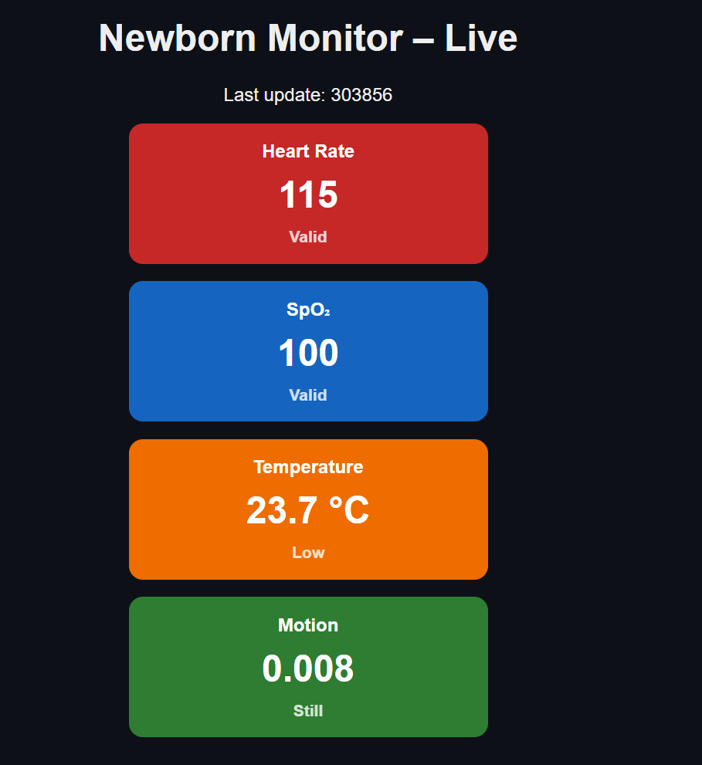
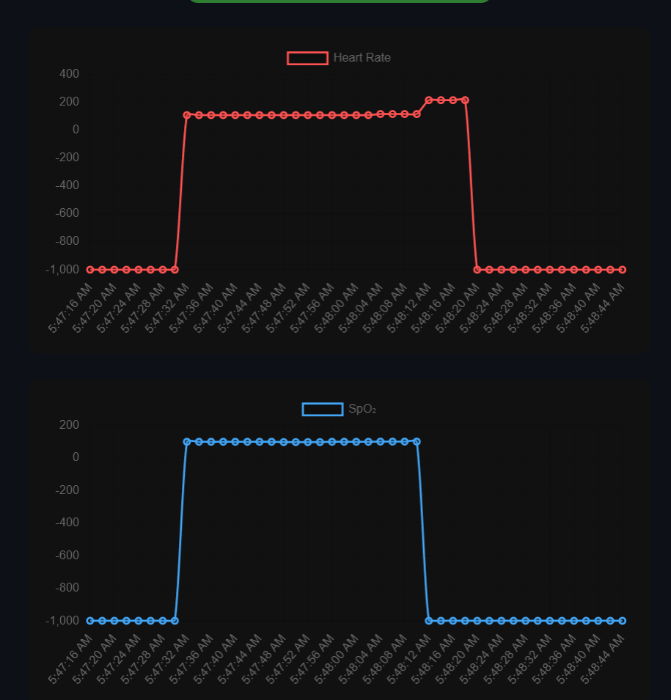
Frontend Dashboard
Served by Nginx on OpenShift
HTML + JS + Chart.js
Fetches /api/latest every 2 seconds
Displays:
  Metric cards
  Live graphs for HR, SpO₂, temp, motion

Slide 9
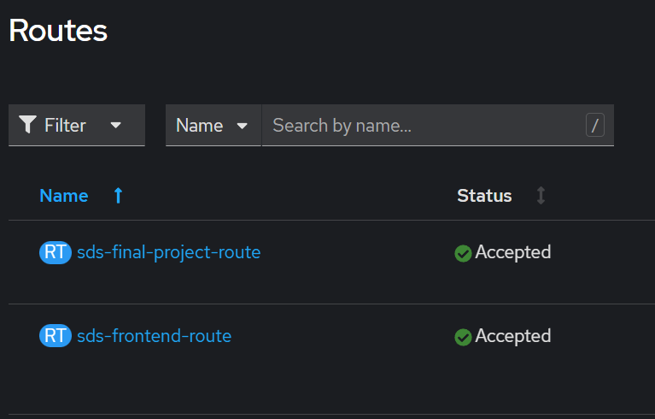
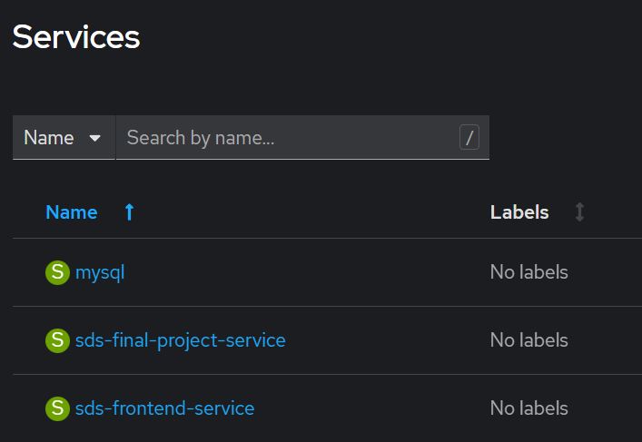
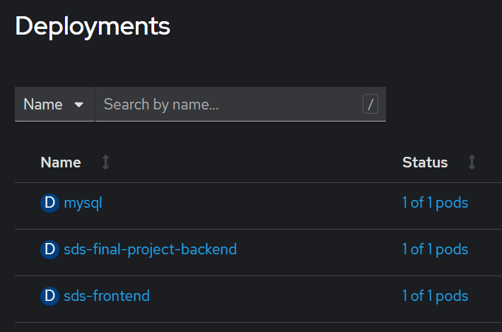
Kubernetes/OpenShift Deployment
Each component containerized
  Deployments manage pods
  Services expose them internally
  Routes expose frontend + backend externally
Ensures scalability and resilience

Slide 10
REST Instead of MQTT
Simpler integration with browser
No need for MQTT broker management
Easier debugging (curl, Postman)
Reliable transactional writes
MQTT better for large multi-device systems

Slide 11
Software-Defined Systems Concepts
Edge computing: device-side measurement
Software-defined storage: DB as abstracted layer
API-driven architecture: Clear control and Data planes
Containerized Nature shows SDI principles

Slide 12
Challenges
Sensor issues.
Malformed or inconsistent JSON sent to the backend.
Route misconfigurations leading to inaccessible frontend/backend URLs.
Nginx Path Issues
Port Issues

Slide 13
Future Improvements
Add alerting for abnormal vitals
Multi-device support
WebSockets for real-time streaming
Add authentication & Role Based Action Control

